Slide 1

Heart Disease Classification
Mini Project 2
David Muwandi
20.03.21

Slide 2

Heart Disease
Heart or Cardiovascular disease is an umbrella term which refers to conditions that involve narrowed or blocked blood vessels that can lead to a heart attack, chest pain or stroke. Other heart conditions, such as those that affect your heart’s muscle, valves or rhythm, also are considered forms of heart disease.

Slide 3
Socio Economic Impact
Deaths
Cardiovascular disease (CVD) was the underlying cause of death in 41,800 deaths in 2018 (26% of all deaths) according to the Australian Institute of Health and Welfare (AIHW) National Mortality Database. It was an associated cause of death in 70,600 deaths
Economic Cost
Treating CVD often involves large surgical procedures, lengthy recovery periods, loss of independence and loss of income. In addition, many people who experience a cardiovascular event, such as heart attack or stroke, will take time off work, resulting in losses to their employer
Health System expenditure for heart disease exceeded $6.2 billion, with a further $26.0 billion in lost wellbeing -due to short and long-term disability, and premature death.
Deaths
Cardiovascular disease (CVD) was the underlying cause of death in 41,800 deaths in 2018 (26% of all deaths) according to the Australian Institute of Health and Welfare (AIHW) National Mortality Database. It was an associated cause of death in 70,600 deaths
Economic Cost
Treating CVD often involves large surgical procedures, lengthy recovery periods, loss of independence and loss of income. In addition, many people who experience a cardiovascular event, such as heart attack or stroke, will take time off work, resulting in losses to their employer
Health System expenditure for heart disease exceeded $6.2 billion, with a further $26.0 billion in lost wellbeing -due to short and long-term disability, and premature death.

Slide 4
Business Question
Can we leverage on data to reduce the impact of heart disease?

Slide 5

Opportunity
80 % of heart diseases is preventable because many of its risk factors are modifiable. These include biomedical risk factors such as high blood pressure, insufficient physical activity, overweight and obesity, and tobacco smoking.
Early identification of individuals at risk allows for cheap interventions to mitigate or reduce the risk and impact of the disease.

Slide 6




Data Pipeline
Business Question
Data Acquisition
Training & Evaluation
EDA & Preprocessing
Report
6

Slide 7
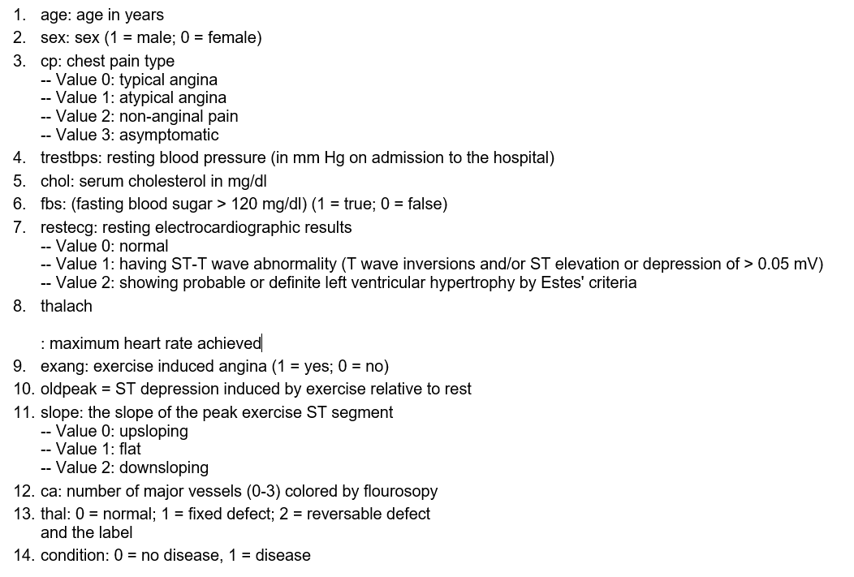
Data Set
FEATURES & DISCRIPTION
Source: Kaggle Cleveland dataset
SHAPE: ( 303,14)

Slide 8
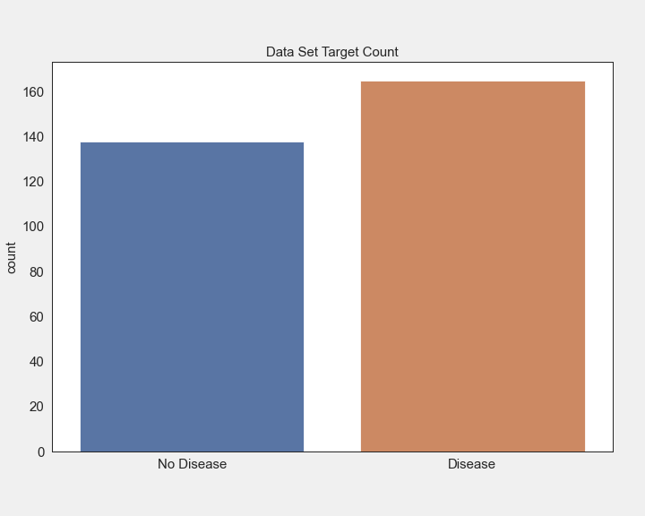
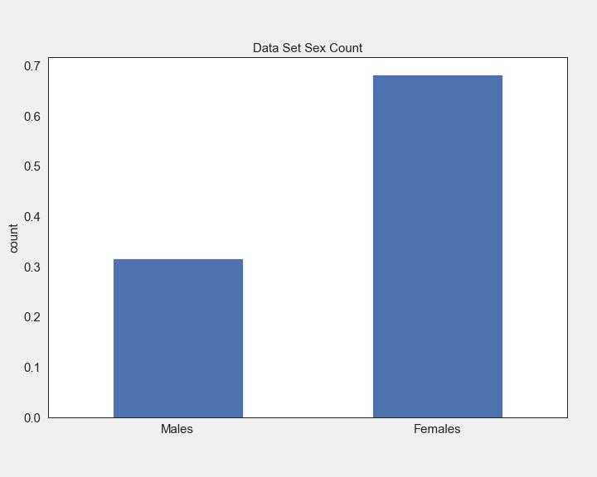
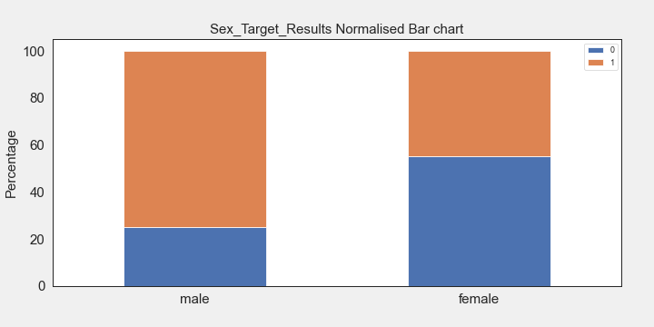
Heart Disease and Gender
Data set is balanced 54:46 target split
Males: Females 32: 68
75% of males tested positive
45% of females tested positive
A higher prevalence of heart disease among male patient

Slide 9
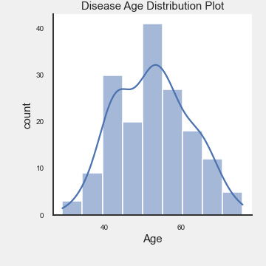
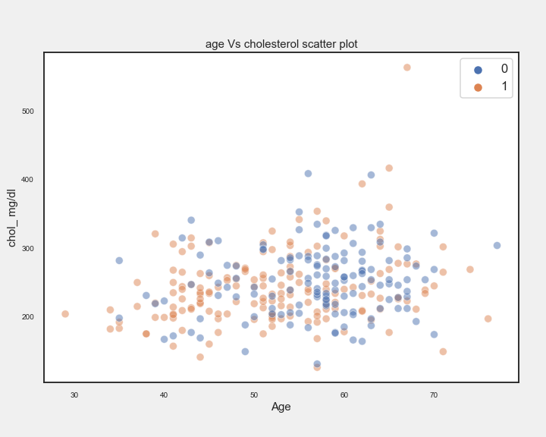
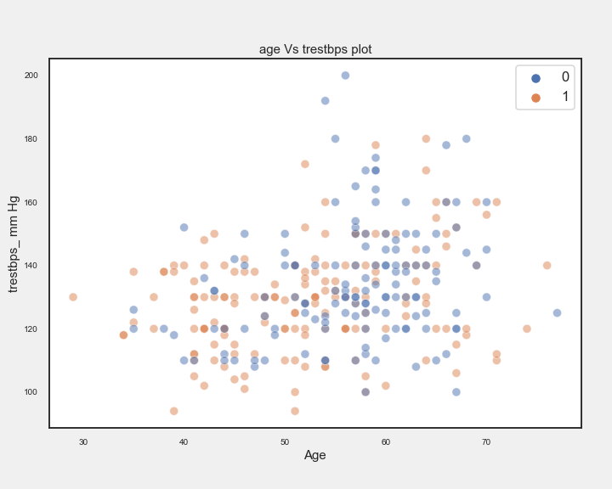
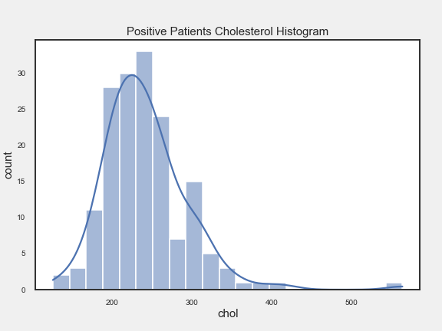
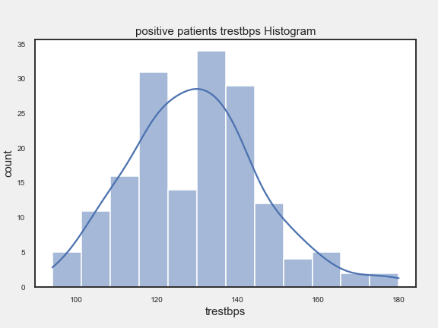
Demographics
High cholesterol (150mg/dl) prevalent in 40 – 70 age group
Heart disease cases prevalent in 40 – 60 age group.
trestbps increasing with age
Age, cholesterol, trestbps normally distributed among positive patience

Slide 10
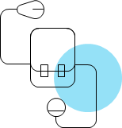
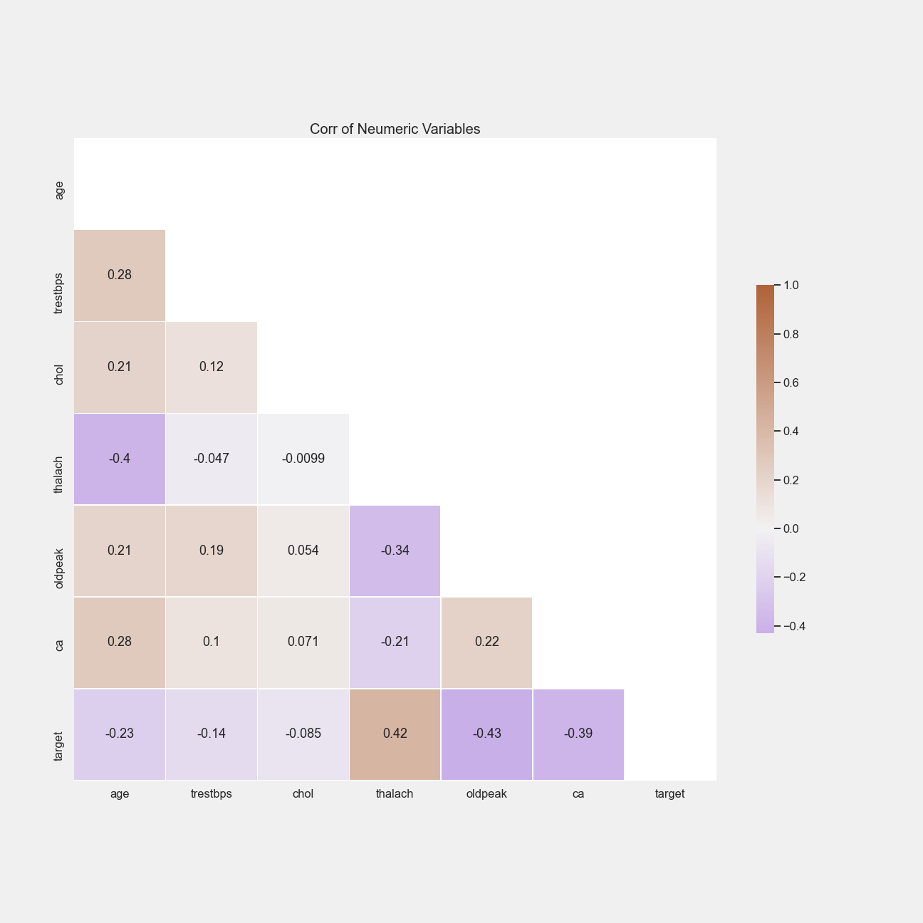
Numeric variables correlation

Slide 11
Training & Evaluation
Model | Recall
Logistic Regression | 82
Support Vector Machine | 92
Naive Bayes | 79
Model evaluation based on Recall
Support Vector Machine Model Produced best results achieving 92% accuracy
SVM failed to correctly classify the least number of positive cases hence the best model

Slide 12
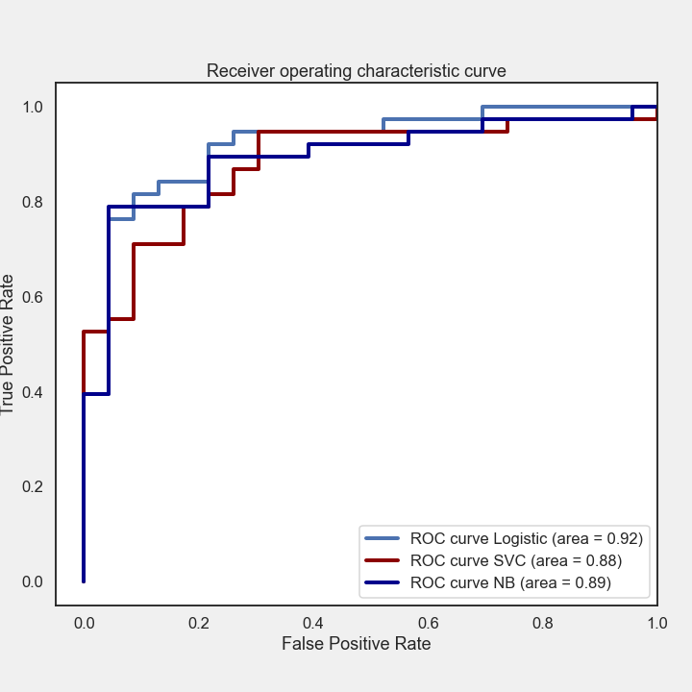
Model Selection
Overall performance Logistic Regression had heist score
Medical domain accuracy is best measured/explained using recall
S.V.M is best model with 92% recall

Slide 13
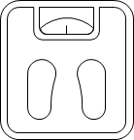
Benefits of using Predictive Model
Lives will be saved. Early detection can be the difference between life and death
Quick and accurate diagnosis of patience
Early intervention may be taken to reduce the risk factors which can be controlled
Reduction in heart disease related emergencies and associated heath care expenditures
Provides a better chance to individuals at risk for a continued productive life and wellbeing

Slide 14
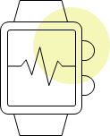
What’s Next
Business Case - Quantify /Estimate the economic benefit
Project approval
Pilot test model
Scale up - phased role out

Slide 15
Summary
Heart disease has a heavy social and economic
80% risk factors are preventable
Predictive model will quickly and accurately identify patients at risk
Lives will be saved
Heart disease related health expenditure will be reduce

Slide 16
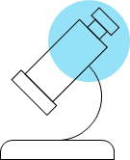
Questions
THANK YOU

